Slide 1


EVALUATION
OF THE IMPACT OF THE CROSS-BORDER COOPERATION PROGRAMME POLAND-BELARUS-UKRAINE 2014-2020
ON THE SUPPORT AREA
PRESENTATION OF THE STUDY RESULTS

Slide 2
STUDY METHODOLOGY
Desk research
CAWI/CATI
Case studies
Delphi method
Network analysis
Media query
Measurement of outcome indicators
In-depth interviews

Slide 3
NUMBER OF BENEFICIARIES
Entity country of origin | Number of leaders | Number of partners | Number of individual projects (without partners) | Total number of entities
Poland | 91 | 107 | 7 | 205
Belarus | 17 | 60 | - | 77
Ukraine | 42 | 109 | 1 | 152
Total | 150 | 276 | 8 | 434

Slide 4
STRUCTURE OF PARTNERSHIPS
Among the partnerships, those consisting of a leader and one partner predominated, accounting for more than half of all partnerships. One in four projects was carried out in a consortium consisting of a leader and 2 partners, while just over 8% were implemented in a consortium consisting of a leader and 3 partners. Larger project consortia were rare, but there were projects with up to 7-10 partners in addition to the leader.

Slide 5
PREDOMINANT TYPES OF BENEFICIARIES
Poland
Local government communities
Gmina-level government organisational units
Belarus
Local government communities
Ukraine
Local government communities
State-level organisational units
Associations

Slide 6
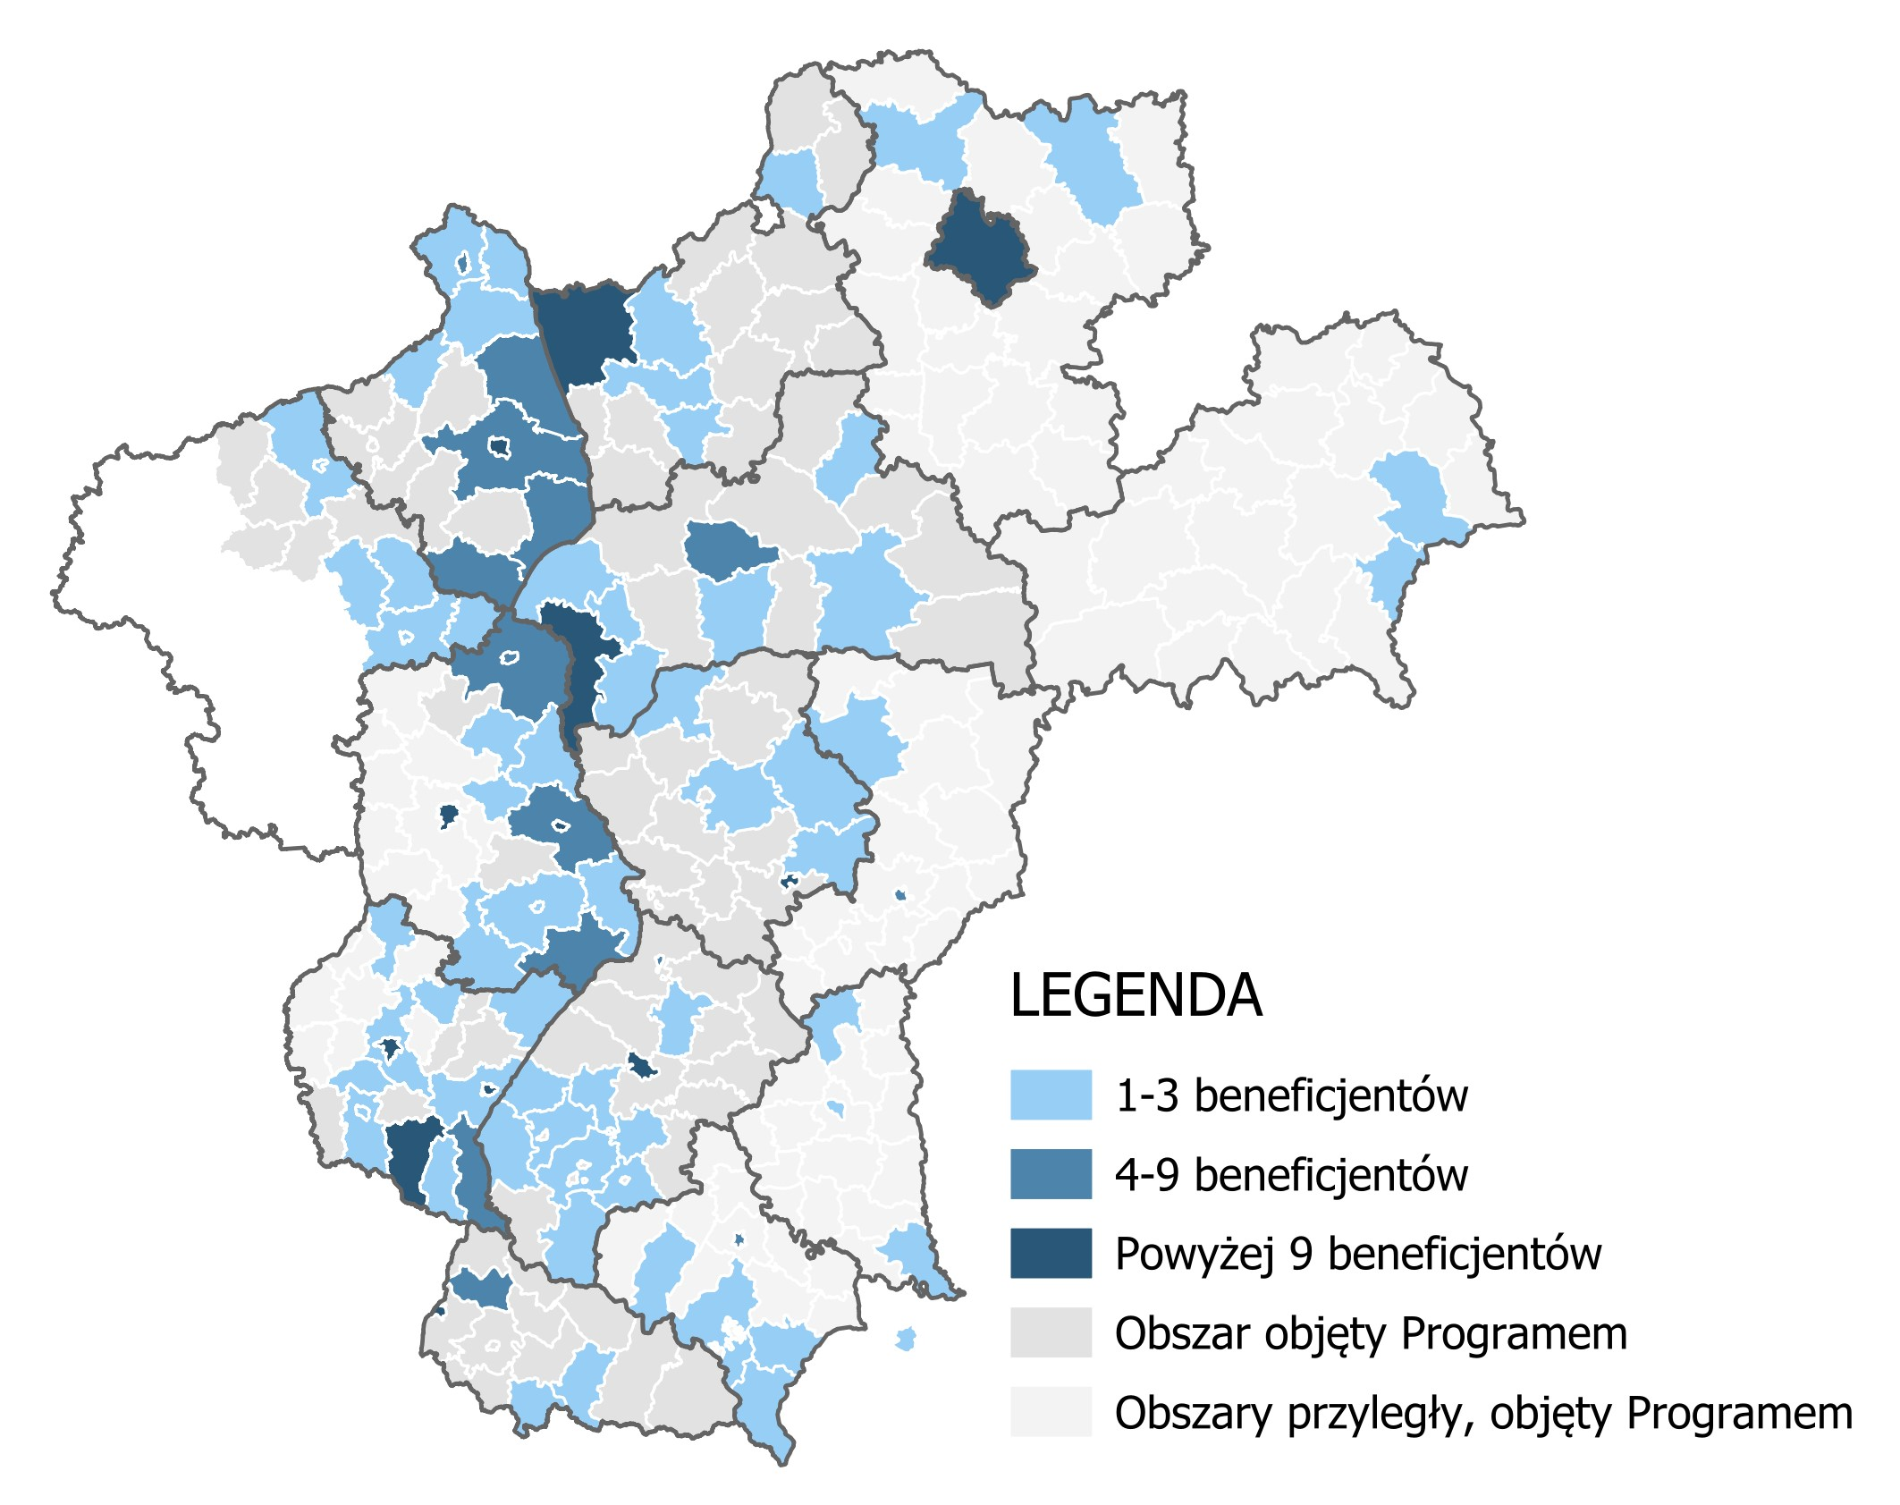
BENEFICIARIES BY LOCATION
LEGEND
1-3 beneficiaries
4-9 beneficiaries
More than 9 beneficiaries
Area covered by the Programme
Adjacent area covered by the Programme

Slide 7
PROJECT OUTCOMES
Product indicator | Subject-matter objective | Target achievement level
Number of improved cultural, historical, tourist and nature sites directly created as a result of Programme support | HERITAGE | 26.29%
Number of cross-border cultural events organised with ENI support | HERITAGE | 34.95%
Number of cross-border events organised with Programme support | HERITAGE | 48.00%
Number of nature sites promoted and/or protected as a direct consequence of Programme support | HERITAGE | 46.38%
Number of people taking part in campaigns and measures to raise awareness and promote the protection of nature heritage | HERITAGE | 49.25%
Total length of newly built roads | ACCESSIBILITY | 183.62%
Total length of altered or modernised roads | ACCESSIBILITY | 81.09%
Number of poviats benefiting from modernised/established transport services and infrastructure | ACCESSIBILITY | 70.00%
Number of partnerships formed to modernise/create environment-friendly transport systems or services | ACCESSIBILITY | 85.71%
Number of partnerships created to develop ICT | ACCESSIBILITY | 100.00%
Population benefiting from better health care as a direct consequence of support | SECURITY | 60.16%
Population benefiting from newly established or improved social services | SECURITY | 106.88%
Population benefiting from fire protection services as a direct consequence of support | SECURITY | 84.58%
Number of security institutions cooperating across the border | SECURITY | 152.94%
Number of border crossings with an increased capacity | BORDERS | 43.75%
Increased capacity at land border crossings | BORDERS | 203.24%

Slide 8
INTENSITY OF CONTACT BETWEEN PARTNERS

Slide 9
INTENSITY OF CONTACT BETWEEN PARTNERS
8.14
Average rating of the sufficiency of meetings before the outbreak of war in Ukraine
The nearly three-year pandemic preceded the outbreak of war in Ukraine and the announcement that the programmes involving Russia and Belarus were suspended. It certainly affected how the partners communicated and delayed certain plans (…).
Source: A personal in-depth interview.
5.63
Average rating of sufficiency of meetings following the outbreak of war in Ukraine
As part of the quantitative study, beneficiaries and partners were asked whether they felt that the number of meetings between the lead beneficiary and partners was sufficient for proper project implementation. There is a noticeable deficiency in this respect. While a relatively high level of satisfaction was reported before the outbreak of the conflict (a mean score of 8.14 on a scale of 1-10), after the outbreak this metric is rather average (a mean score of 5.63 on a scale of 1-10).

Slide 10
SATISFACTION WITH COOPERATION WITH PARTNERS
8.37
Average level of satisfaction with cooperation with partners before the outbreak of war in Ukraine
Although the intensity of cooperation dropped very sharply, satisfaction with the cooperation did not fall as significantly. The average rating before the outbreak of conflict in Ukraine was 8.37, and after the outbreak of conflict it was 6.60. Thus, the decline in satisfaction with cooperation is less than the decrease in the intensity of cooperation itself.
6.6
Average level of satisfaction with cooperation with partners following the outbreak of war in Ukraine

Slide 11
FURTHER PROJECT PLANS
The chart presents the responses of the surveyed beneficiaries and project partners to the question ‘Do you plan to implement a project as part of any Territorial Cooperation Programme that is carried out in the financial perspective 2021-2027?’.
The factors which determine the choice of a programme by potential beneficiaries include the alignment of the planned investment with the subject-matter activities implemented under the programme in question, and experience obtained from projects implemented under the selected programme. Knowing the partners and positive experience of past cooperation in other projects is important in deciding whether to apply as part of a programme. Geographical proximity to the prospective partner is another factor that scored highly among those surveyed.

Slide 12
DETERMINANTS OF PARTNERSHIP COMPOSITION
When analysing the factors which influenced the establishment of partnerships as part of the evaluated Programme in the 2014-2020 perspective, it should be noted that partners considered factors such as, among others, knowing the partner, making it easy to establish cooperation, followed by positive experience with previous cooperation, receiving a proposal for cooperation and geographical proximity to the partner. Other factors included establishing partnerships as a result of searches for the purpose of applying for support under the Programme.

Slide 13
SUSTAINABILITY OF PROJECT OUTCOMES
Project beneficiaries were very positive about the sustainability of the outcomes of their project. None of the beneficiaries taking part in the survey said that the outcomes were unlikely to be sustained beyond the end of the project.
There is no threat to the sustainability of the Project or the sustainability of its outcomes. The warranty period for the completed works is 7 years.
Personal in-depth interviews.

Slide 14
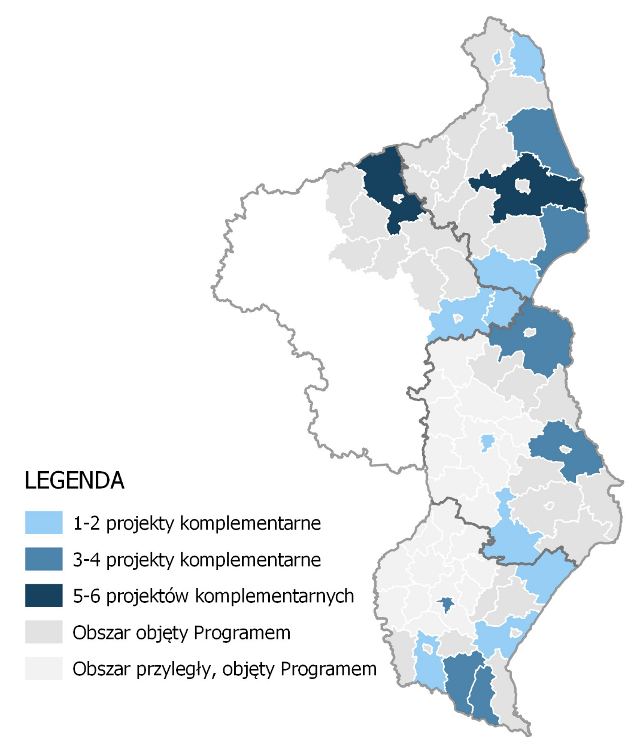
COMPLEMENTARITY OF PROJECTS
Projects implemented as part of the evaluated Programme were usually complementary to projects implemented using ROP funds. This is because of the relatively extensive use of these funds by the entities also benefiting from Programme funds. Furthermore, as pointed out in interviews with beneficiaries in the case studies, the ROP funds are perceived by the beneficiaries as relatively easier to obtain, e.g. because the application can be prepared in Polish. All beneficiaries of the Cross-border cooperation programme Poland-Belarus-Ukraine 2014-2020 who implemented projects using other funds also benefited from the ROP.
LEGEND
1-2 complementary projects
3-4 complementary projects
5-6 complementary projects
Area covered by the Programme
Adjacent area covered by the Programme

Slide 15
HORIZONTAL PRINCIPLES
RESPONSES FROM POLISH BENEFICIARIES
When analysing the results of CAWI among Polish and Ukrainian beneficiaries and project partners regarding the project's reference to individual horizontal principles, it must be noted that the distribution of responses was comparable. However, the Ukrainian partners attached greater importance to ensuring that their activities had a positive impact on the horizontal principles.
No difficulties were reported by beneficiaries having to refer to the horizontal principles.
RESPONSES FROM UKRAINIAN BENEFICIARIES

Slide 16
STUDY CONCLUSIONS AND RECOMMENDATIONS

Slide 17
CONCLUSIONS AND RECOMMENDATIONS (1)
Identified problem | Conclusion | Recommendation | How to implement the recommendation | Expected effect of implementing the recommendation
High level of territorial concentration of support | A high level of support concentration is observed in the Programme. The support focuses primarily on Polish cities with poviat rights and 3 Ukrainian regions. It is also concentrated in large localities with more than 100,000 inhabitants (especially on the Ukrainian side). In addition, there are white spots (places where not even a single project from the Programme has been implemented) in the support area, even in the case of localities close to the border. | It is recommended to introduce mechanisms to promote an even distribution of support. | The mechanisms should be implemented in the form of promotion (e.g. providing additional scoring at the application assessment stage) for projects in which at least one of the entities participating in the project consortium represents an entity based in a poviat near the border. | Increased representation of poviats and gminas, which are currently white spots. Greater proportionality in the distribution of support across the area.

Slide 18
CONCLUSIONS AND RECOMMENDATIONS (2)
Identified problem | Conclusion | Recommendation | How to implement the recommendation | Expected effect of implementing the recommendation
Loss of ties with partners in Belarus | Entities from Belarus represented the smallest group of beneficiaries, both among leaders and partners. Nevertheless, the loss of ties affects the prospects for cross-border cooperation in the support area. The established partnerships, albeit relatively few in number, have disintegrated and, as a consequence, it is not possible to respond jointly to cross-border challenges and threats. Some form of compensation to make up for the project vacuum may be the inclusion of the support area in other cooperation programmes. | It is recommended that the Łomża sub-region, included in the eligible area of the programme by virtue of EC Implementing Decision 2023/1638 of 14 August 2023, is maintained as part of the Lithuania-Poland INTERREG Programme 2021-2027. | It is recommended to preserve the current form of the Lithuania-Poland INTERREG Programme 2021-2027 in terms of the extent of support on the Polish side. | Inclusion of sub-regions which have lost partners from Belarus in other cross-border, trans-regional and inter-regional programmes.

Slide 19
CONCLUSIONS AND RECOMMENDATIONS (3)
Identified problem | Conclusion | Recommendation | How to implement the recommendation | Expected effect of implementing the recommendation
Challenges in supporting cross-border environmental projects | The study found significant interest from prospective applicants in water and sewerage infrastructure, and water management measures. This type of investment was particularly welcome in Ukraine. However, the Programme did not directly envisage this type of projects. Considering the significant needs in this area as well as the need to implement pilot projects in Ukraine on the introduction of EU standards in water and wastewater management, and in the area of nature conservation and biodiversity and rational management of natural resources, it is reasonable to finance such measures under the Interreg NEXT Programme Poland-Ukraine 2021-2027 and the new Programme after 2027. | It is recommended to continue to support joint cross-border measures in the area of the environment and the prevention of the negative effects of climate change in the following financial perspectives. | Establishing a priority concerning the environment and the prevention of the negative effects of climate change as part of the Interreg NEXT Programme Poland-Ukraine 2021-2027 and the new Programme after 2027. | Improving the state of the environment through cross-border projects on adaptation to climate change and the prevention of risks associated with natural disasters, water management, nature and biodiversity conservation and pollution reduction as part of the Interreg NEXT Programme Poland-Ukraine 2021-2027 and the new Programme after 2027.

Slide 20
CONCLUSIONS AND RECOMMENDATIONS (4)
Identified problem | Conclusion | Recommendation | How to implement the recommendation | Expected effect of implementing the recommendation
Need for more involvement of children and youth in the projects | According to the study, more emphasis should be placed on joint activities (educational, integration) aimed at children and young people as part of ongoing projects, because this social group has great potential to build future cooperation based on mutual understanding and openness, free of historical prejudices. | It is recommended to provide additional incentives for the implementation of educational and integration measures aimed at children and young people as part of the projects implemented under the priorities: Environment, Tourism, Health and Accessibility. | At the application assessment stage, giving preference to projects involving the implementation of educational and integration activities aimed at children and young people. | Achieving greater involvement of the younger generations in building positive cross-border relations and attitudes based on mutual respect and openness.

Slide 21
CONCLUSIONS AND RECOMMENDATIONS (5)
Identified problem | Conclusion | Recommendation | How to implement the recommendation | Expected effect of implementing the recommendation
Need to identify possible solutions to respect the horizontal principles | Difficulties in understanding the horizontal principles, above all the principle of sustainable development, were identified in the study. This concerned mainly the Ukrainian beneficiaries. | In the 2021-2027 financial perspective, it is reasonable to carry out training to present possible solutions for individual types of projects, or to develop a good practice document in this regard, as already indicated in the previous programme evaluation study. | Training for beneficiaries consisting in the presentation of a catalogue of solutions for the implementation of the horizontal principles in projects. Creating a best practice guide for possible solutions to implement the horizontal principles. | Improved understanding of the importance of the horizontal principles, and achieving greater awareness among the beneficiaries.

Slide 22
CONCLUSIONS AND RECOMMENDATIONS (6)
Identified problem | Conclusion | Recommendation | How to implement the recommendation | Expected effect of implementing the recommendation
Need for information and promotion measures aimed at various target groups | The evaluation shows that the high effectiveness of the information and promotion measures was linked to the implementation of various activities aimed at specific target groups. In the case of measures aimed at applicants and beneficiaries, training and workshops, the possibility of direct contact with WST staff and the website delivered the best results. In the case of measures involving the dissemination of knowledge about the Programme among the public, the most effective measures were open meetings and activities that required participants to become personally involved (competitions, quizzes, etc.). | The information and promotion measures undertaken in the 2014-2020 perspective should be continued, in particular using a wide range of communication tools that are well suited to the needs of the target audience. | At the beginning of the perspective, combining events to take stock of the outcomes of 2014-2020 projects and providing information on new support opportunities. Keeping opportunities for direct contact with WST representatives (email, phone) and ensuring that adequate human resources are available at WST. Keeping the website highly usable by posting information quickly, publishing all materials needed (guidelines, templates, regulations, guides, etc.). Organise training (also online, unless contraindicated) and workshops (the most effective form is to be decided on a case-by-case basis) for applicants and beneficiaries. Organising events (including annual ones ) in the form of open meetings for residents with many engaging activities for the participants (competitions, urban games, quizzes, sports competitions). | Maintaining the high utility of information and promotion measures. Achieving the objectives of the programme’s Communication Strategy for 2021-2027.

Slide 23
THANK YOU.

